Slide 1

Unlocking Insights: Advertisements Click-through Rate(CTR) Analysis
Enhancing Marketing Performance for Product X

Slide 2
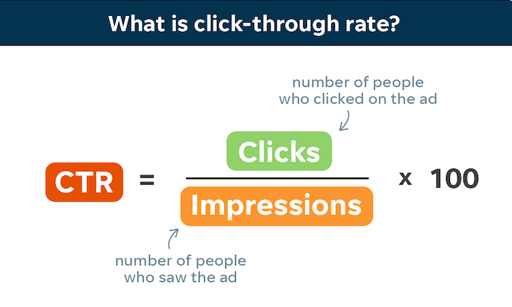
Introduction to Ads Click–Through Rate
Formula for calculating CTR :
What is CTR?
CTR, or Click-through Rate, measures the percentage of people who click on an ad compared to the total number of people who see it.

Slide 3
Problem Statement
ABC company's extensive marketing efforts through Google Ads, DV360, Facebook, have not translated into desired conversions for Product X.
Despite significant investments, the click-through rate (CTR) metrics indicate challenges in engaging and converting potential customers
Issues:
Inadequate conversion rates despite substantial investment.
Suboptimal performance of ads across various online platforms.
Difficulty understanding underlying reasons for low CTR and conversions.

Slide 4
Objectives
Assess effectiveness of advertising campaigns
1
Analyse key metrics: CTR, impressions, clicks, and budget utilization.
2
Trends and Patterns: Explore trends over time and across channels.
3
Identify correlations between metrics for insights.
4
Actionable Insights: Derive insights to optimize campaign strategies.
5
Recommend adjustments for better ROI and outcomes.
6
Create a GUI using tkinter library.
7

Slide 5
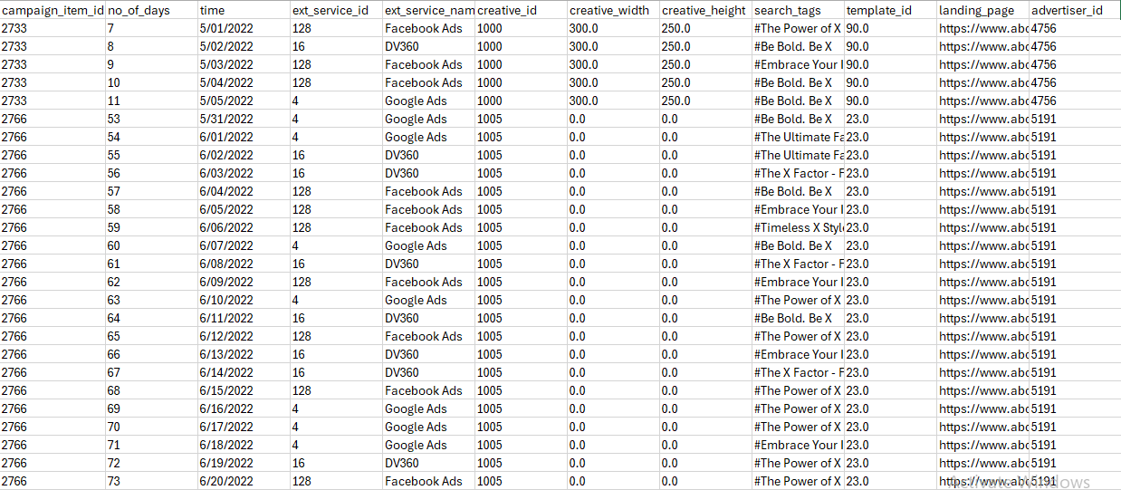
Dataset Overview:

Slide 6
Data Description :
campaign_item_id : unique id of each advertising campaign
no_of_days : number of days the campaign has been running
time : timestamp on which the data was captured
media_cost_usd : the amount of money that the campaign has spent on that particular day
search_tags : search tags used for displaying ads
channel_name : name of the channel (display, search, social, mobile video)

Slide 7
Data Description :
campaign_budget_usd : overall budget of the campaign or the amount of money that the campaign can spend.
impressions: The number of times an advertisement is displayed on a website or social media platform.
clicks: The number of times an advertisement is clicked on by a user, leading them to the advertiser's website or landing page.
ext_service_name: name of each advertising platform used
keywords : a word or set of words that Google Ads advertisers can add to a given ad group so that your ads are targeting the right audience

Slide 8
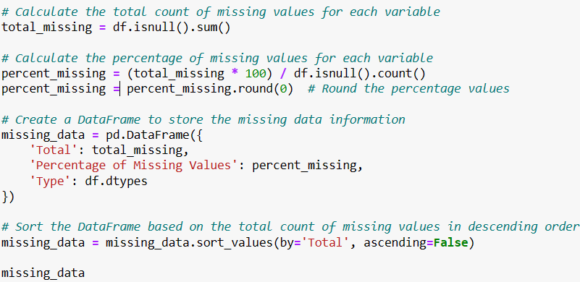
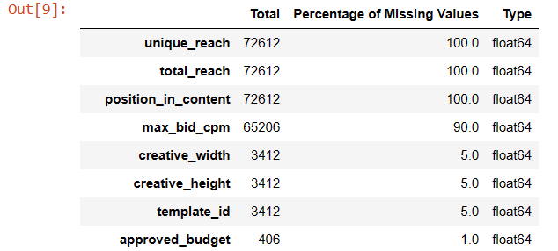
Data Pre-processing Steps:
Handling missing Values :
Filled missing values with 0 in specific columns like creative width, creative_height, template_id, approved_budget using fillna() method
First four columns in the table we obtained for missing values shows there are more than 80% of missing values for each column. In such cases its better to drop column. So we dropped the column using drop(columns =[])

Slide 9
Data Pre-processing Steps:
Creating New Columns:
ctr : df['ctr']=(df['clicks']/df['impressions'])*100
spent_budget_per_day : df['spent_budget_per_day'] = df['campaign_budget_usd'] / df['no_of_days’]
Datetime Conversion:
Converted the ‘time’ column to datetime format using pd.to_datetime(df[‘time’])

